Slide 1
7FNCE040W
Business Analytics
WEEK 3 Bite 3
REVIEW of WEEK 3

Slide 2
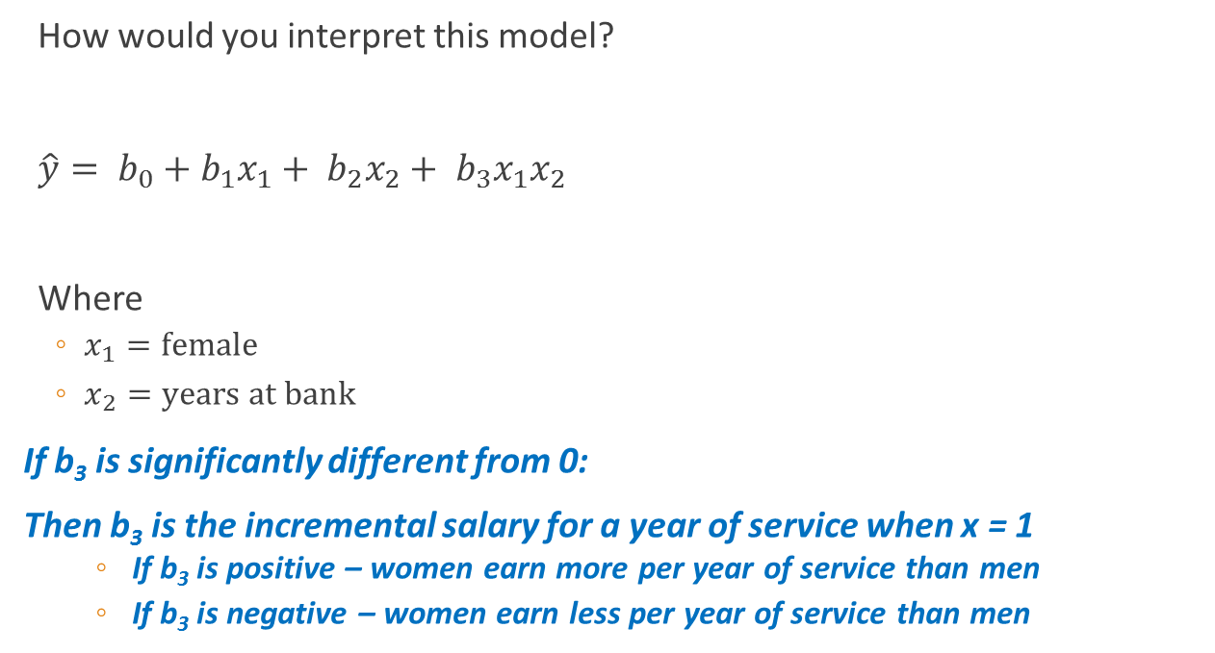
Food for Thought
How would you interpret this model?
$\hat{y}= b_{0}+b_{1}x_{1}+ b_{2}x_{2}+ b_{3}x_{1}x_{2}$
Where
$x_{1}=\text{female}$
$x_{2}=\text{years} \text{at} \text{bank}$
If b₃ is significantly different from 0:
Then b₃ is the incremental salary for a year of service when x = 1
If b₃ is positive – women earn more per year of service than men
If b₃ is negative – women earn less per year of service than men
Notes:
If b₃ is significantly different from 0:
Then b₃ is the incremental salary for a year of service when x = 1
If b₃ is positive – women earn more per year of service than men
If b₃ is negative – women earn less per year of service than men

Slide 3
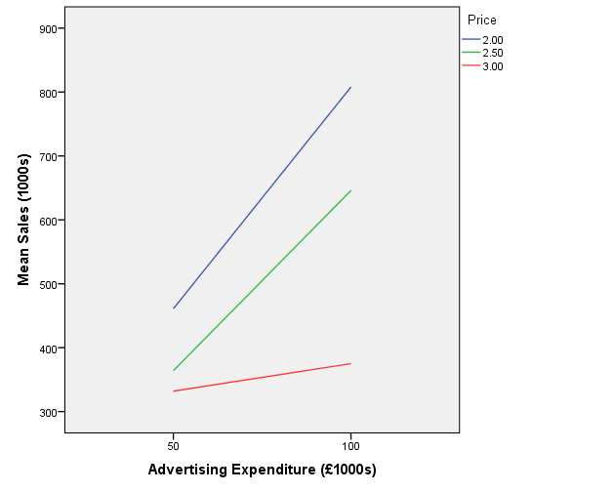
Interpretation
Assume
x₁ = advertising exp.
x₂ = price
The change in Y due to x₁ depends on the value of x₂.
The change in Y with a 1 unit change in x₁ produces a change of b₁ + b₃x₂
Notes:
Graph
Legacy Dialog
Line → Multiple
Summaries for Groups of Cases
Define
Lines Represent
Other Statistic (Mean)
Variable: Sales
Category: Advertising Expenditure
Define Lines By: Price
Each line has a different slope
Advertising’s impact on sales differs depending on the price

Slide 4
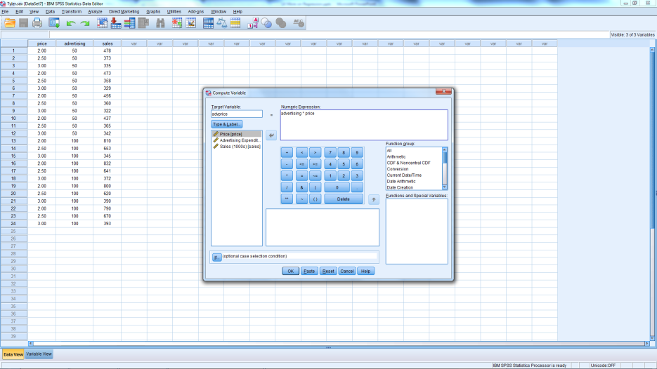
Creating an Interaction Term
Open Tyler.sav
Transform → Compute Variable
Target Variable: advprice
Numeric Expression: Adv*Price

Slide 5
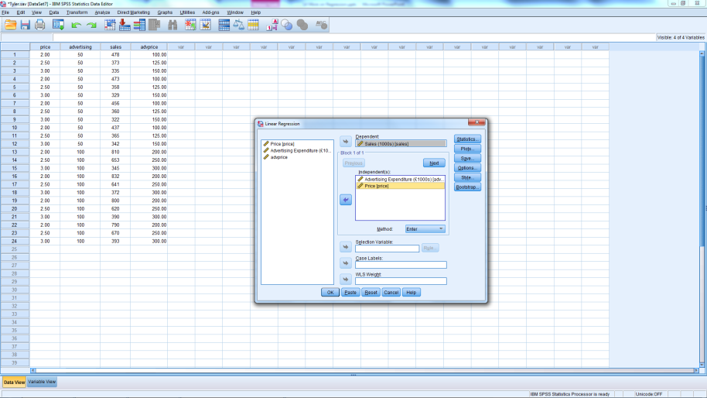
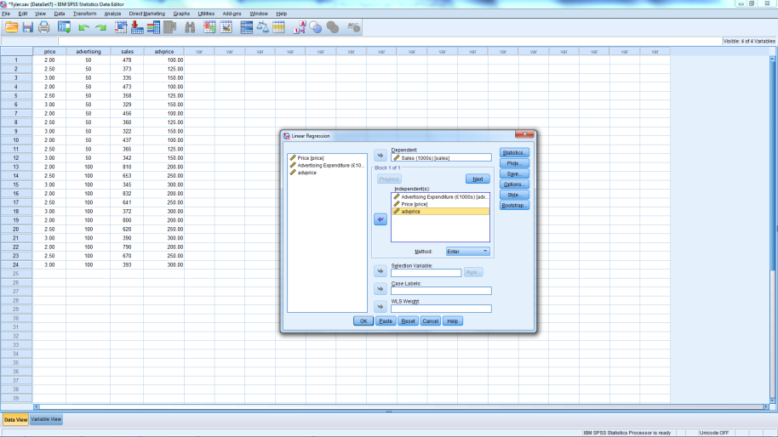
Estimate 2 Models of Sales
Adv & Price
Adv & Price & Adv*Price

Slide 6
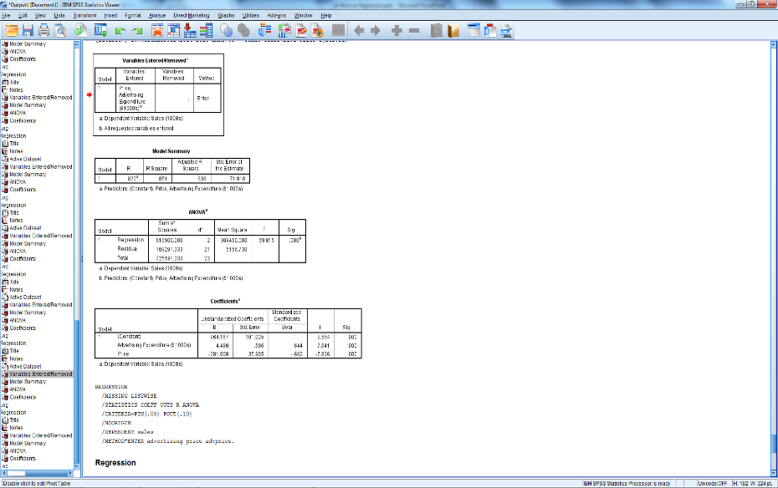
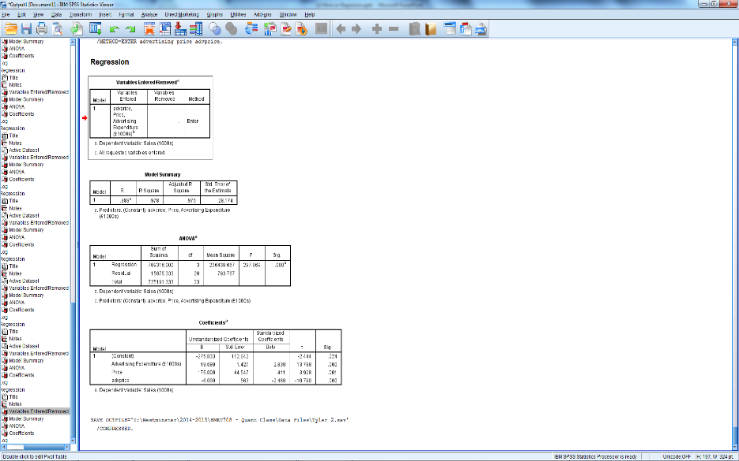
Which model is better?
w/o Adv*Price
w/ Adv*Price

Slide 7
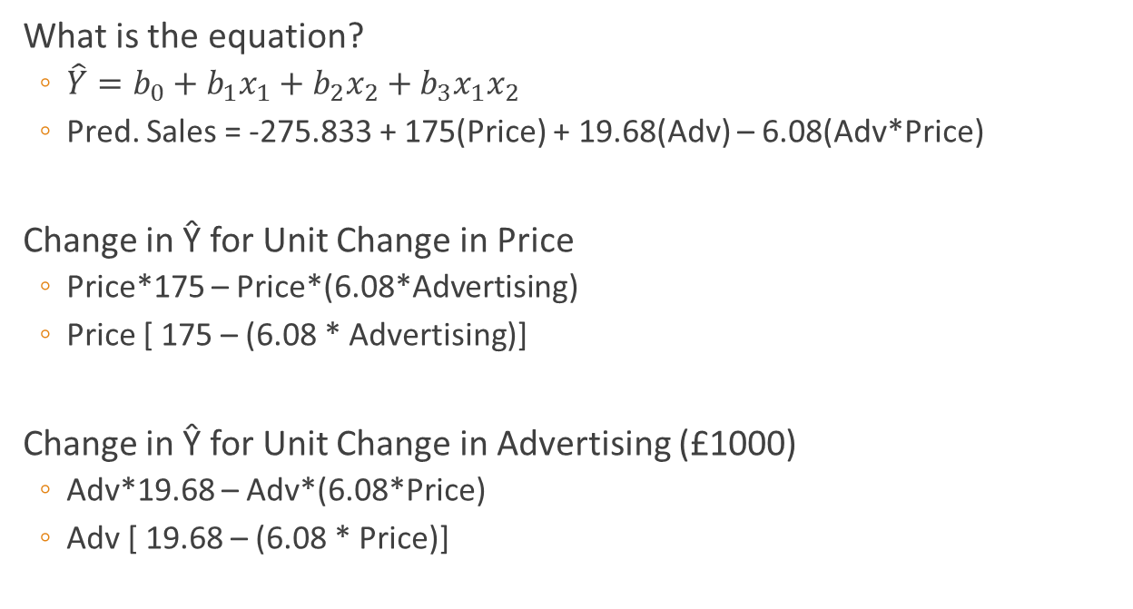
Interpreting the Coefficients
What is the equation?
$\hat{Y}=b_{0}+b_{1}x_{1}+b_{2}x_{2}+b_{3}x_{1}x_{2}$
Pred. Sales = -275.833 + 175(Price) + 19.68(Adv) – 6.08(Adv*Price)
Change in Ŷ for Unit Change in Price
Price*175 – Price*(6.08*Advertising)
Price [ 175 – (6.08 * Advertising)]
Change in Ŷ for Unit Change in Advertising (£1000)
Adv*19.68 – Adv*(6.08*Price)
Adv [ 19.68 – (6.08 * Price)]
Notes:
Note that if the interaction term is significant, the main effects (x1 and x2) must be included in the model, even if not significant.

Slide 8
Note
If the interaction term is significant
Leave components (main effects) in estimated model
Even if not significant
If interaction term is not significant
Delete from model and re-estimate
Include only significant components main effects

Slide 9
Problems in Regression
Outliers

Slide 10
Problem: Outliers
Errors in data entry
Valid but exceptional situation
Exceptional without likely explanation
Ordinary by individual variables but unusual combination

Slide 11
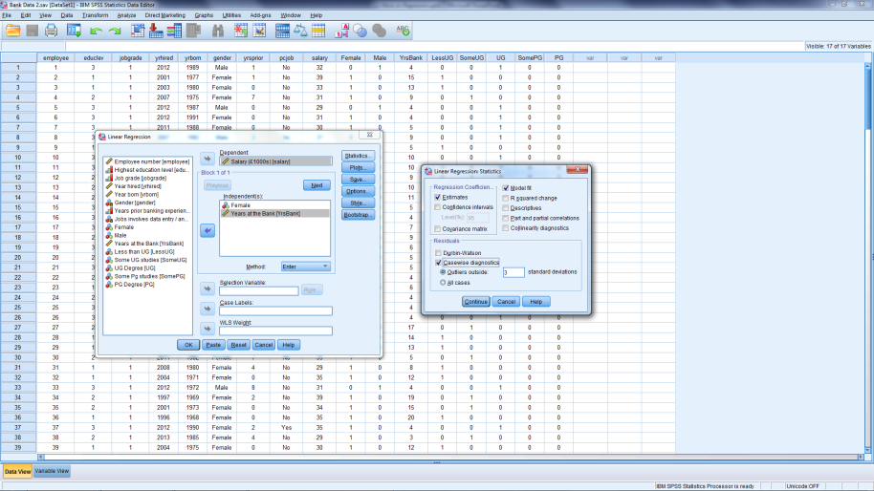
Residual Analysis
Open Bank Data 2.sav
Rerun the regression
Female
Yrs at Bank
Select Statistics box
Click Statistics Box
Under Residuals
Select Casewise Diagnostics
Notes:
Outlier: Data that are more extreme than majority
Detection
Looking at graphs of the data
With software
SPSS
Analyze / Regression / Linear
Statistics / Casewise diagnostics
Outliers > 3 standard deviations
EXCEL: residual plots
Usually a decision made by researcher

Slide 12
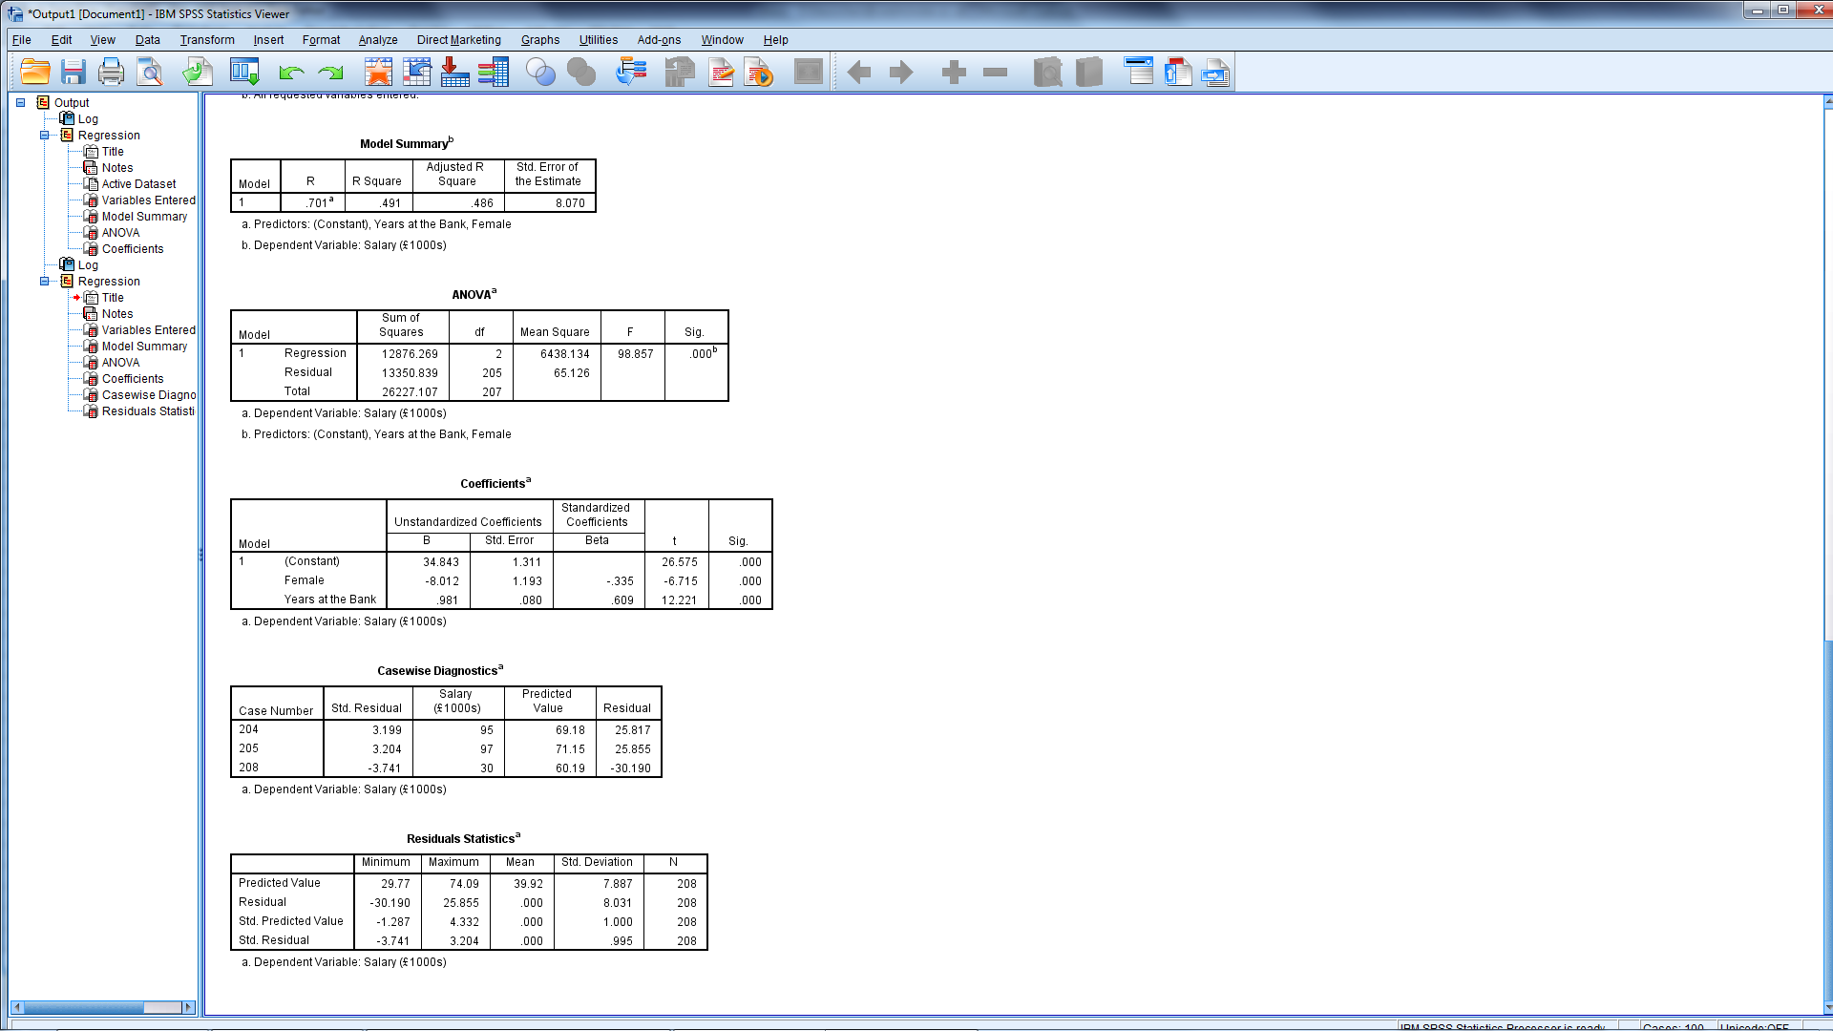
Regression Output

Slide 14
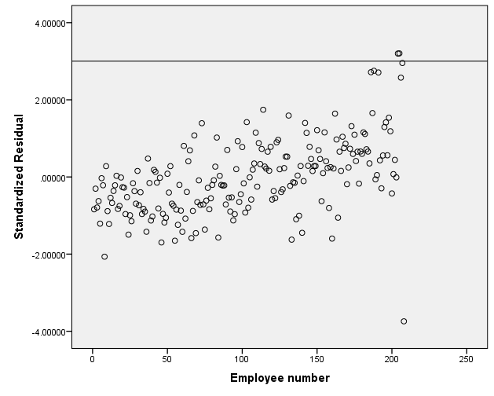
Residuals (Errors)
204 & 205
208

Slide 15
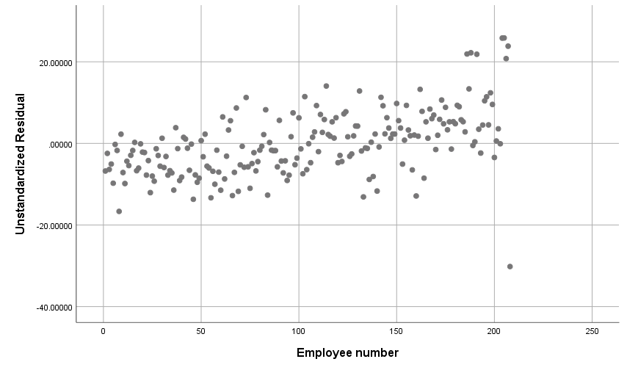
Errors -Scatter diagram of residuals vs employee

Slide 16
Problem: Outliers
Emp | Edu Level | Job Grade | Yr Hired | Yr Born | Gender | Yrs Prior | PC Job | Salary
204 | 3 | 6 | 1981 | 1955 | Male | 0 | No | 95
205 | 5 | 6 | 1979 | 1954 | Male | 0 | No | 97
208 | 5 | 6 | 1982 | 1953 | Female | 0 | No | 30
Fix data errors
Make decisions about:
Unexplained exceptional observations
Exceptional yet valid observations
Guard against deleting those that are different, while representative

Slide 17
Problems
Multicollinearity

Slide 18

What is Multicollinearity?
Notes:
Multicollinearity occurs when independent variables are so highly correlated with each other that it is difficult to come up with reliable estimates of their individual regression coefficients.
When two variables are highly correlated, they are basically measuring the same phenomenon or construct. In other words, when two variables are highly correlated, they both convey essentially the same information.
Essentially, one variable cannot be held constant while the impact of the other on the dependent variable is estimated.

Slide 19
Showtime Movie Example
Open data file Showtime.Sav
Predict weekly gross revenue as a function of advertising
Run correlations of all three variables
Run two simple regressions
Predict revenue from TV advertising
Predict revenue from newspaper advertising
Run one multiple regression
Predict revenue
From both types of advertising

Slide 20
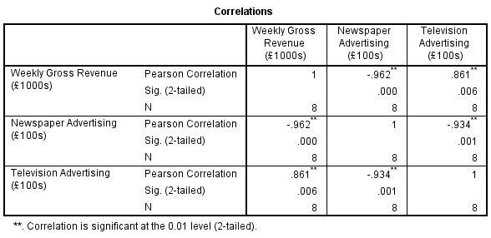
Correlations

Slide 21
Regression Output
Feature | Model 1 | Model 2 | Model 3
F-statistic (Sig.) | 17.195 (.006) | 74.142 (.000) | 36.562 (.001)
R² | .741 | .925 | .936
Adj R² | .698 | .913 | .910
Television Adv. (Sig.) | 1.595 (.006) |  | -.540 (.399)
Newspaper Adv. (Sig.) |  | -1.961 (.000) | -2.516 (.011)

Slide 22
Regression Output
Feature | Model 1 | Model 2 | Model 3
F-statistic (Sig.) | 17.195 (.006) | 74.142 (.000) | 36.562 (.001)
R² | .741 | .925 | .936
Adj R² | .698 | .913 | .910
Television Adv. (Sig.) | 1.595 (.006) |  | -.540 (.399)
Newspaper Adv. (Sig.) |  | -1.961 (.000) | -2.516 (.011)

Slide 23
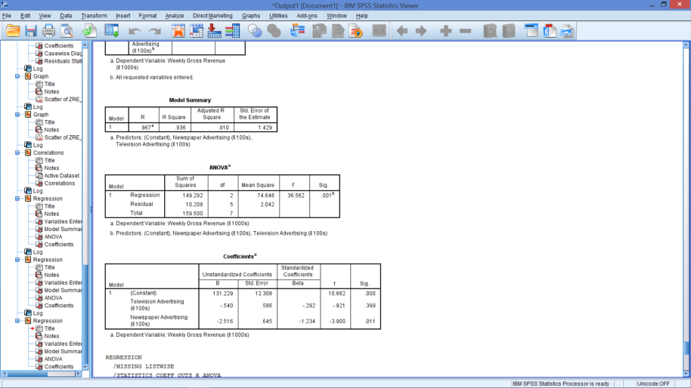
Effects of Multicollinearity
Parameter Estimates
Unstable
May have wrong sign
Parameters appear unhelpful
May appear insignificant
May not reject null hypotheses

Slide 24
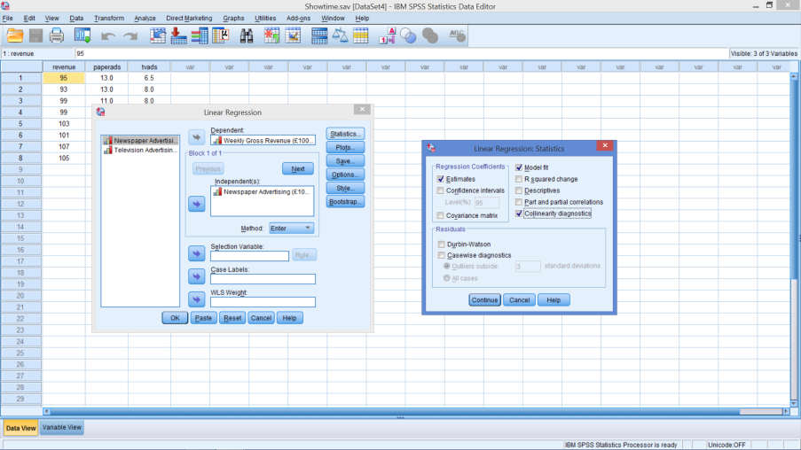
Identification
Redo Multiple Regression
Before hitting OK
Select the Statistics box
Check Collinearity diagnostics
Continue
OK

Slide 25
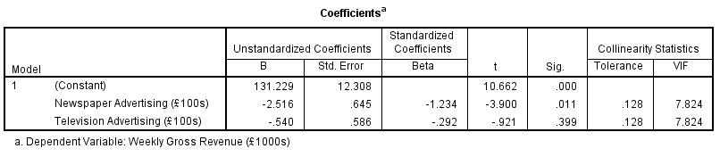
Identification
Tolerance
Amount of variation not explained by other IVs
Similar to 1 – R² → Want this to be high
VIF ≡ Variance Inflation Factor = 1 / Tolerance
VIF > 10 is common threshold
Notes:
Collinearity Diagnostics
Tolerance: amount of variation not explained by other independent variables
Intuitively similar to 1-R²
Want this to be high – low indicates a problem
As R2 increases – Tolerance decreases
VIF ≡ Variance Inflation Factor = 1/ tolerance
VIF > 10 is common threshold (without other evidence)
(Don’t worry about other diagnostics provided)

Slide 26
Detecting Multicollinearity
Correlations between IVs > .9 or < -.9
Unexpected signs on estimated coefficients
Large F (or Adj. R²), small t
VIF nearing or > 10
Cumulative Impact of all Indications
Notes:
No one piece of evidence is sufficient – addressing multicollinearity depends on the accumulation of evidence
Correlation among independent variables
Not really independent variables
Can’t hold one constant and assess impact of another
Large F, small t indicates that there is still a good fit of the regression line (high Adj. R²), but the individual parameter estimates are not good

Slide 27
What to do – The Task
Assess degree of multicollinearity
Determine the impact on results & necessary remedies
Keep your own objective in mind

Slide 28
What to do – The Remedy
Omit one or more of the highly correlated variables
Use the model for prediction or forecasting only
Make no attempt to interpret the coefficients
Which one?
Rerun model

Slide 29
In-class Exercise
Open Restaurant.sav again
Assume the Year measures length of time in business
Run Regressions predicting sales
Does Multicollinearity appear to be present?
If so, what next?
From Prev Adv., Adv., Population
Then add Year
Check Collinearity Diagnostics
How do you know?
Anything suspicious?
Run correlation including year

Slide 30
Multicollinearity Evidence
From correlations
Correlation between Year and Population = .986
Regression Output – Increased Adj. R²
Year is not significant
Now negative sign
Now insignificant
VIF
Population >>> 10
Year >>> 10
What should be done?
Use as is for predictions
Update model without one or more of collinear variables
Population
Notes:
From correlations
Correlation between Year and Population = .986
Regression Output – Increased Adj. R²
Year is not significant
Population
Now negative sign
Now insignificant
VIF
Population >>> 10
Year >>> 10
What should be done?
Use as is for predictions
Update model without one or more of collinear variables

Slide 31
What’s Next?
Topic
Logistic Regression
Readings
Chapter 3 & 4

